Slide 1
İMAGE AND SİGNAL PROCESSİNG PROJECT
License plate recognition
By: Emin Bayramov

Slide 2

İntroduction
Automatic Number Plate Recognition (ANPR) is a highly accurate system capable of reading vehicle number plates without human intervention
License plate detection is advanced way of building fundamental for this system.

Slide 3
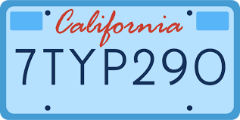
Aim
Aim of the project is to build software that takes image input and provide new image with license plate has been added next to plate itself, which illustrates that software is able to detect license plate.

Slide 4





Methodology
OpenCV
NumPy
Imutils
EasyOCR
Project has been built on Jupyter Notebook with Python language fundamentals.
! Matlab is required, but I do not have laptop, this was the reason my failure last semester, I was hoping to use university’s labs, but quarantine did not allow. I built this project on company’s laptop where I work, and we are not allowed to use other software tools.
open-source computer vision and machine learning software library.
library for the Python programming language, adding support for large, multi-dimensional arrays and matrices
translation, rotation, resizing, skeletonization, and displaying Matplotlib images easier with OpenCV
allows computer vision developers to perform Optical Character Recognition. When it comes to OCR, EasyOCR is by far the most straightforward way to apply.

Slide 5
Training and plate detection structure
1
2
3
4
5
6
Read image
Noise reduction
Edge detection
Detecting possible
Detecting possible rectangle shaped object
Mask that object
Show gray scale
Show image
Remove rest from image
shapes
12
11
10
9
8
7
Show result
Border license plate
Place text result on input image
Select highest probability guess
Use EASYOCR
Crop selected object
Scale up
Read text from new image
Print text

Slide 6
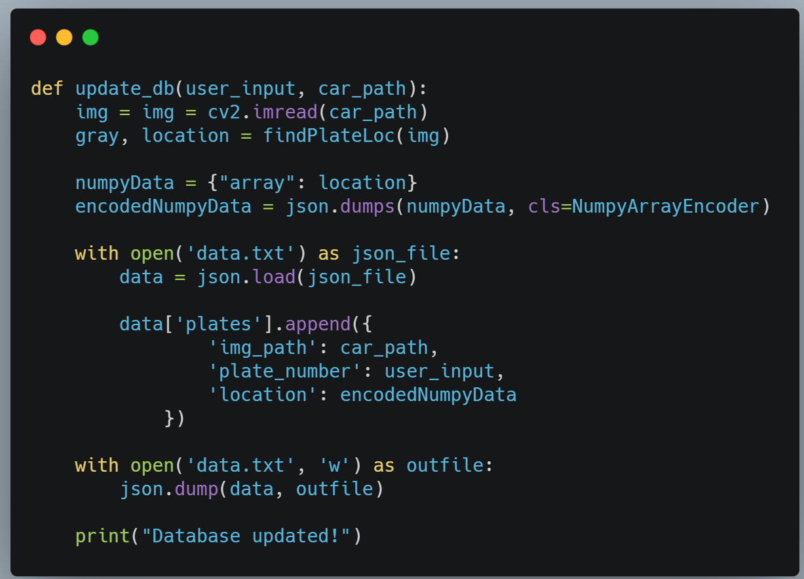
Required updates by Professor
Do not implement project based on 1 image – Right now, function start_training works on 50 images as data set
Have more than 1 scenario – Right now, I am taking text input to allow user to search for specific plate in database and print image and plate as result
Have extendable dataset – if searched plate is not in database by using tkinter I allow user to upload different image
Data that you got from project is not saved – I am saving training data on json file
What is the accuracy of performance – Now, I am checking accuracy of prediction and print with image

Slide 7
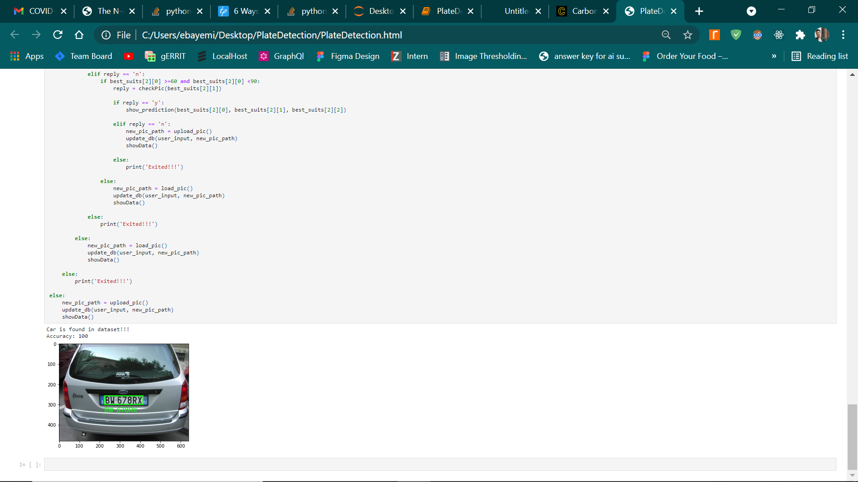
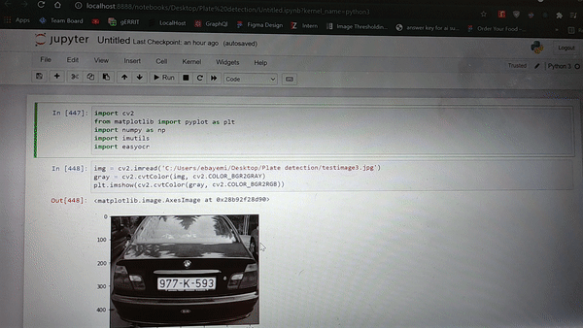
Result
Updated version of project is more user-friendly and allow us to update
database based on request.

Slide 8
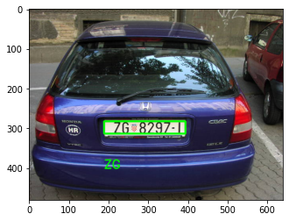
Discussion
1. As I am searching for exactly rectangle shape as generally so, different shaped plates’ location can be detected but not exactly.
2. In Croatian license plates there is flag in the middle of plate. As I am trying to read each element by using EASYOCR, it reads until flag.

